Slide 1

A comparative study between statistical and machine learning methods for forecasting retail sales Shanmugapriya Murugavel Student No: R00195696 Supervisor: Francisco Hernandez

Slide 2

Background for choosing this project

Slide 3



Software and libraries

Slide 4
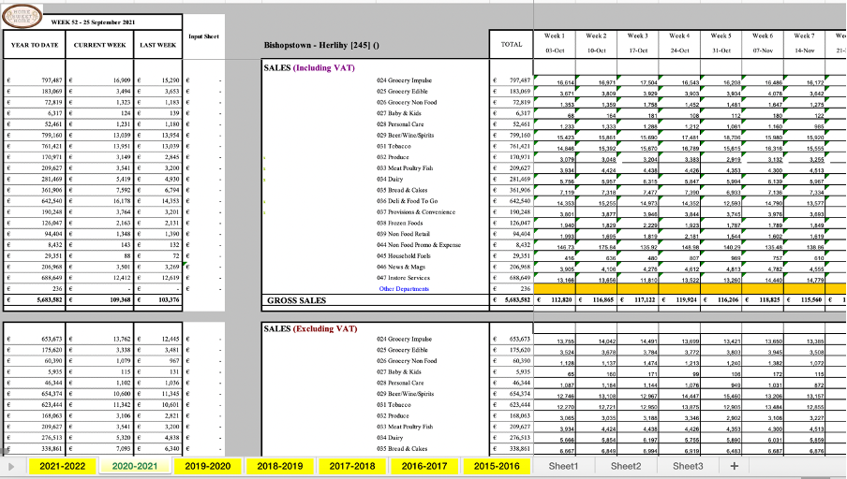
Exploratory Data Analysis

Slide 5
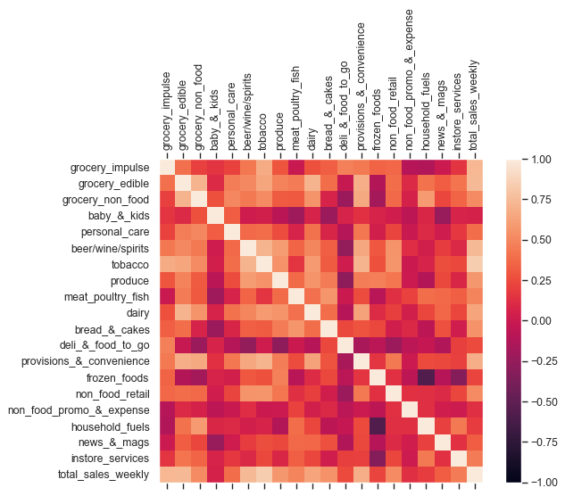
Correlation matrix

Slide 6
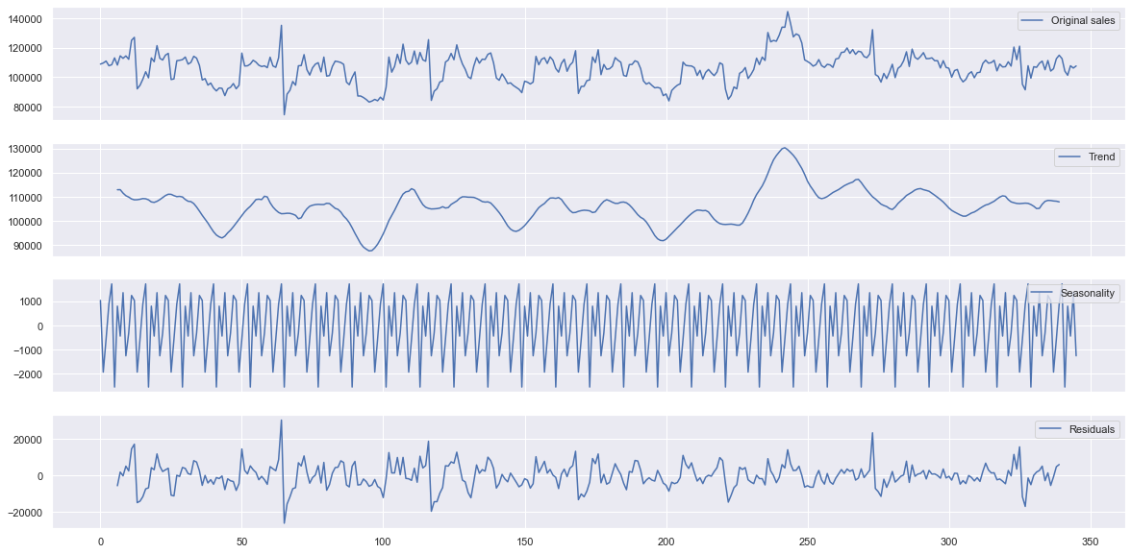
Decomposition of the time series

Slide 7
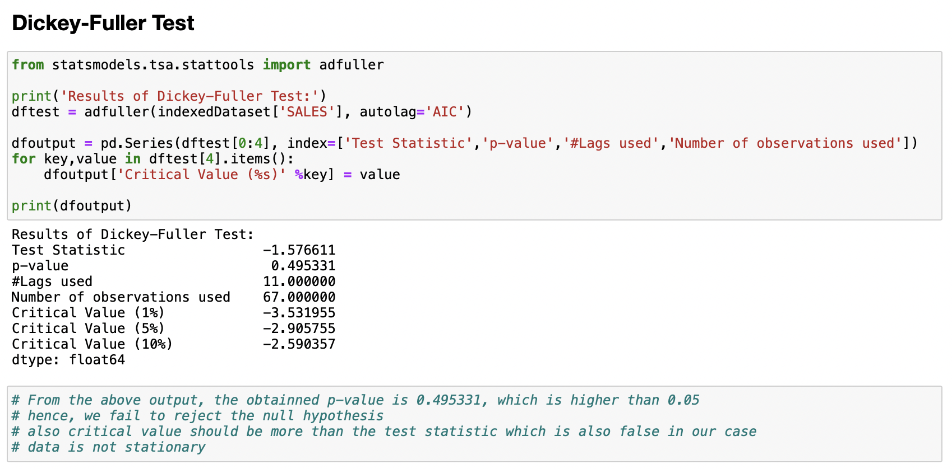
Statistical Models

Slide 8
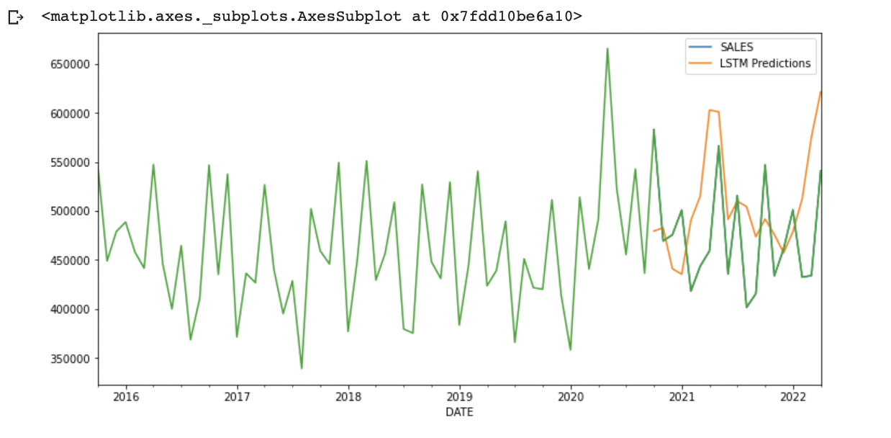
LSTM – Long Short-Term Memory

Slide 9
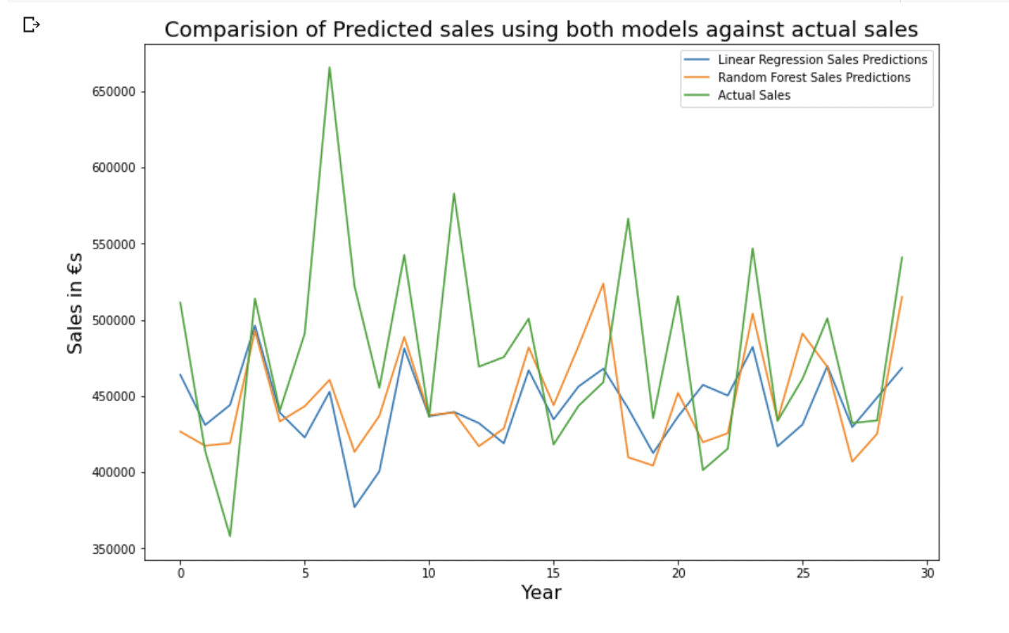
Machine Learning Models

Slide 10
Performance Summary of the different models
Models | RMSE values
LSTM | 61260.98
Linear Regression | 71509.81
Random Forest Regressor | 67903.81

Slide 11
Thank you!

